Slide 1

Material Flow Analysis Fundamentals
Lecture (II): Procedures, Application & Perspectives

Slide 2
Lecture (II): Procedures, applications & perspectives
Index
❶ General context – Why using Material Flow Analysis?
❷What is Material Flow Analysis?
❸ How to carry out a Material Flow Analysis?
General procedure
Illustrative case study: Global aluminium cycle
❹ Perspectives & conclusions
Other types of MFA according to OECD
Other sustainability tools
Summary of the lecture

Slide 3
Lecture (II): Procedure, Application & Perspectives
❸ How to carry out a Material Flow Analysis ?
̶ General procedure

Slide 4
MFA procedure
Define the objectives and parameters to be monitored
Limit the balance scope
Limit the balance period
Identify and define the process steps
Draw the flowcharts: material flows – quality
Draw up the balances: material flows – quantity
Interpret the results and draw conclusions
Goal & Scope
Quantification
Interpretation
Source: United Nations Industrial development Organization (UNIDO)

Slide 5
MFA is an iterative process !
Source: Practical Handbook of Material Flow Analysis, Brunner P.H. & Rechberg H. (2004)
Problem definition / Research question
Goal & Scope
Selection of substances
Determination/ selection of processes
Redefine problem
Determination of system boundaries
adjustment
Adjust system
Determination/selection of goods
Determination of flows and stocks
2. Re-determine goods
Determination of mass flows
1. Refine
mass flows
Balancing the goods
2. Refine mass flows
Determination of concentration
1. Refine concentrations
Balancing of substances
Illustration & interpretation

Slide 6
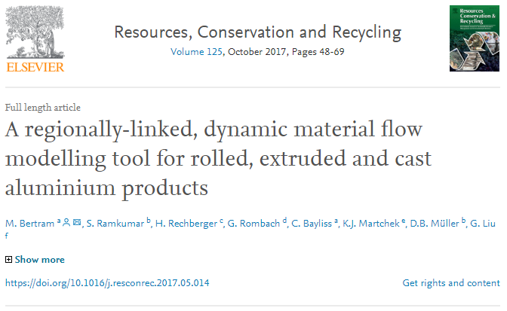

Lecture (II): Procedure, Application & Perspectives
❸ How to carry out a Material Flow Analysis ?
̶ Illustrative case study: the global Aluminum cycle

Slide 7

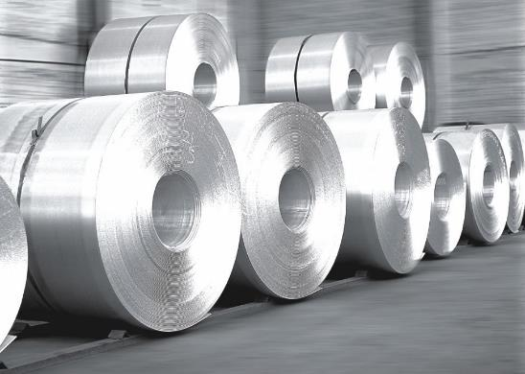
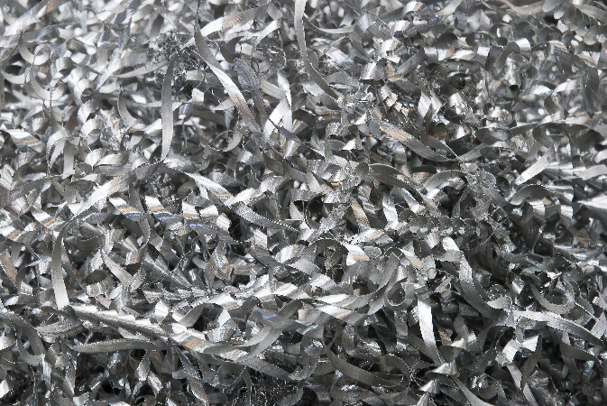
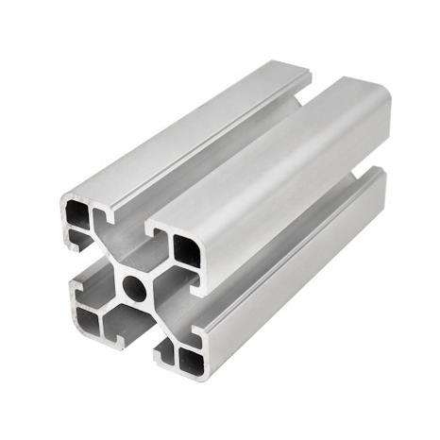
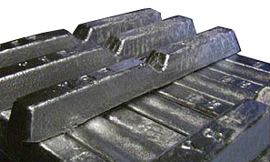
Problem definition / Research question
Goal & Scope
“ The purpose of this study is the quantification of regional stocks and flows of rolled, extruded and casting alloys across space and over time, giving the industry the ability to evaluate the potential to recycle aluminium scrap most efficiently.”
Sources: Asland aluminium, creative commons

Slide 8
Selection of goods & substance
Goal & Scope
Targeted substance: Aluminium
Al
13
Goods:
Primary Aluminium
Recycled Aluminium
Alumina
Bauxite
New and old scrap
Alloys
Semi-finished casting products (ingots)
Final products
26,98
↘ All flows are expressed in Aluminium mass equivalent value
(for Bauxite & Alumina: mass ratio of Aluminium to other constituents)

Slide 9
Spatial and Temporal Boundaries
Goal & Scope
Spatial: Nine regional models representing Worldwide scale
Region | Countries | Comments
China | Mainland China | Important ingot producer &consumer of final products
Europe | EU28+others | Covering regional Europe not only political union
Japan | Japan | Excellent data quality – High per capite consumer of final products
North America | Canada, Mexico, USA | Important ingot producer and co nsumer of final products. Mexico recycles a lot of scrap from USA
Middle east | Arabic peninsula + Iran | Important primary ingot producer. High per capita consumer of final products
Other producing countries | Autralia, Azerbadjan, Russia, South Africa… | Large bauxite, alumina and primary producing regions
South America | Argentina, Brazil, Venezuela, etc. | Covering bauxite mine and high income countries in the South America
Rest of the World | All other countries | No bauxite, alumina or primary aluminium producers. Importer of semis and final products
Temporal: 1950 – 2017 with a particular focus on the year 2014 in the paper
see: http://www.world-aluminium.org/statistics/massflow/

Slide 10
Selection of processes
Goal & Scope
Bauxite mining
Alumina production
Primary production
Recycled production
[Mining & Refining]
[Aluminium production]
Semi-fabricated product manufacture (rolling, extrusion, casting, others
[Fabrication]
[Manufacturing]
Production of final products
Stock of product in-use
[Use]
Management of EOL products
New scrap
[Scrap recovery & Trading]
Short exercise:
List several flows & stocks to be quantified in the system

Slide 11
Identification of flows and stocks
Goal & Scope
Flows:
All the flows between the processes (linking the 6 main stages)
Inter-regional trade (Import/Export of metal & final non-metal products)
Extraction of bauxite in each region
Emission of residues & waste (not recycled)
Stocks:
P1: Stocks of bauxite and Alumina (Alumina refineries, ports, storage facilities)
P3: Aluminium ingot stock
(Aluminum production)
P6: Final product in use
(Anthropogenic stock)
P8: Disposal - landfill & incineration
(Anthropogenic stock)
P9: Bauxite stock change [extraction] (economic reserve is out of the scope)
P10: Residue wastes, metal losses during manufacturing

Slide 12
Draw the flowcharts: material flows – quality
Goal & Scope
Non-metal flows
Metal flows
Other regions
Bauxite
Alumina
Ingots
Semis
Used products
Other uses
New & old scrap
Alloys
Final products
Final products
Final products
EoL Products
Alumina
Ingots
Semis
Mining & Refining
Aluminum Production
Fabrication
Manufacturing
Use
Scrap recovery & trading
P1
P3
P6
Residues
Fabrication scrap
New scrap
Not recycled
Bauxite
Metal loss
New & old scrap
Lithosphere
Disposal & Residue
Disposal & Incineration
P9
P10
P8
World scale = Σ Regional Scales
Region, year

Slide 13
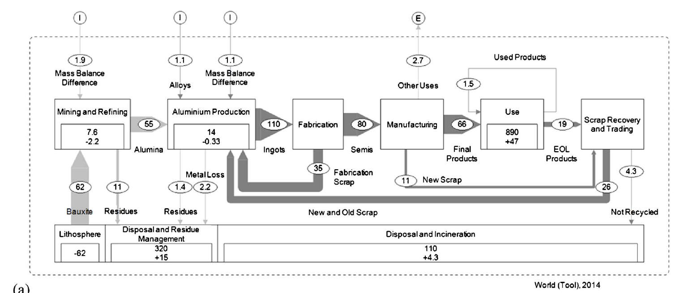
Draw up the balances: material flows (Worldwide scale)
Quantification
All flows are expressed in Aluminium mass equivalent value (in million tonnes)
Stock in 2014 equals stock in 2013 plus the stock change in 2014
Inconsistency in the mass balances

Slide 14

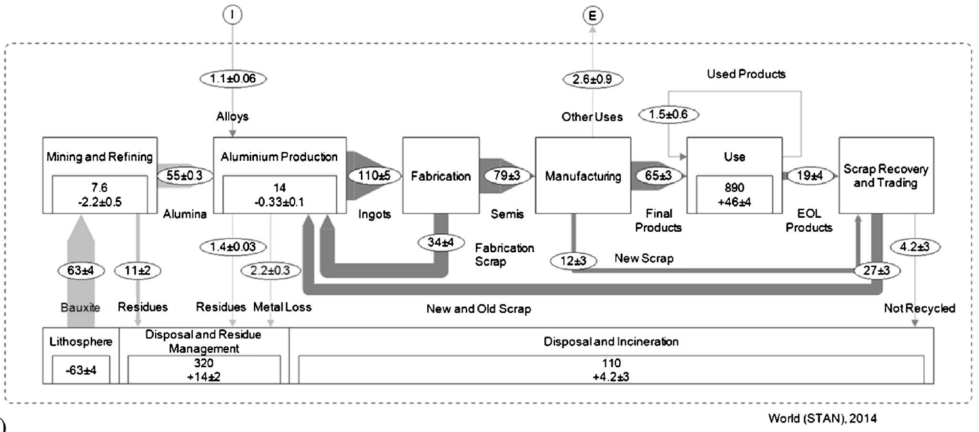
Data reconciliation with STAN sofware
Measurements and estimates are subject to errors (e.g. inconstancies in the law of mass conservation)
Data reconciliation statistically adjusts the values to resolve contradictions and find the data that fit the model the best
Quantification
Most probable value (A) with associated uncertainty (b) is calculated:
A ±b

Slide 15
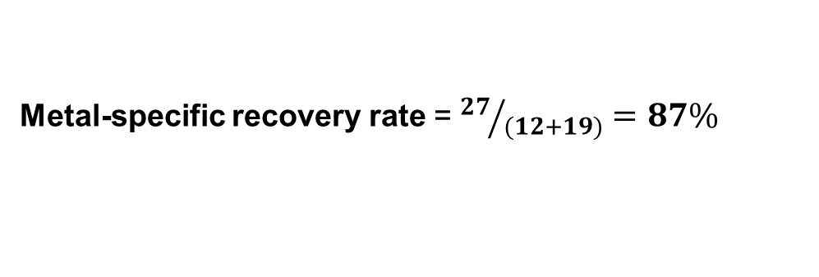
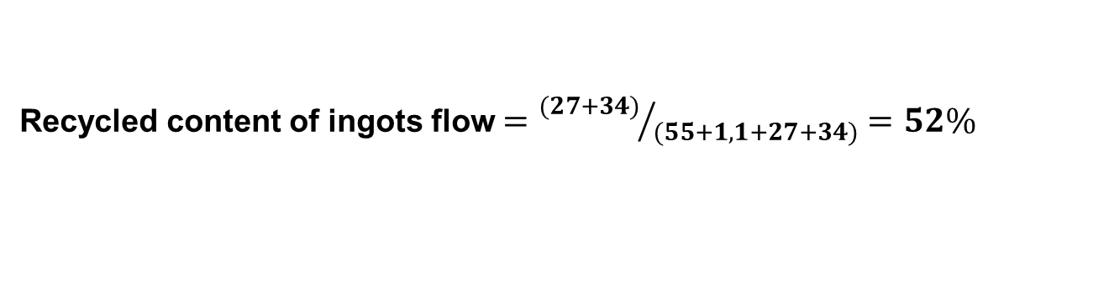
Recycling rates
Interpretation
Metal-specific recovery rate = ${27}/{(12+19)}=87\%$
Recycled content of ingots flow $={(27+34)}/{(55+1,1+27+34)}=52\%$

Slide 16
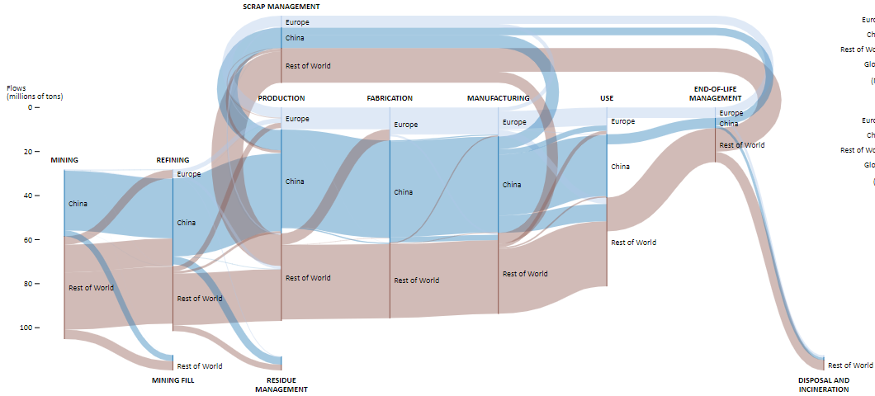
Comparison between the regions in 2017 (China / Europe / Rest of the world)
Quantification
New + Old
scrap
Old
scrap
Bauxite
Alumina + scrap
Ingots
Semis
Final Products
EoL Products
http://www.world-aluminium.org/statistics/massflow/

Slide 17
Comparison of Bauxite & Alumina flows in 2017 (China / Europe)
Quantification
China | Europe
Refining input: 39,9 Mtonnes of Bauxite (67% domestic – 32% import) | Refining input: 4 Mtonnes of Bauxite (4,4% domestic – 95,6% import)
Output: 35,6 Mtonnes of Alumina (total ouputs: 89% Alumina – 9% residue – 2% stocks) | Output: 3,28 Mtonnes of Alumina (total outputs: 81% Alumina – 8% residue – 11% stocks)
http://www.world-aluminium.org/statistics/massflow/

Slide 18
Comparison of Aluminium production in 2017 (China / Europe)
Quantification
China | Europe
Production inputs: 47,2 Mtonnes (77,3% local Aluminia – 20,1% local scrap – 2,6% import scrap) | Production inputs: 10,0 Mtonnes (50,2% local scrap – 26,2% import Aluminia – 21,5% local Aluminia - others)
Production output: 35,9 Mtonnes of primary Aluminium (77,4%) 10,5 Mtonnes of Recycled Aluminum (22,6%) (93,6% domestic – 1% export – 5,4% stocks & others) | Production output: 4,1 Mtonnes of primary Aluminium (46,1%) 4,8 Mtonnes of Recycled Aluminum (53,9%) (98,7% domestic – 1,3% export – 2,4% stocks & others)
Ingots per capita: 3,56 kg | Ingots per capita: 3,00 kg
http://www.world-aluminium.org/statistics/massflow/

Slide 19
Comparison of in-use stock and flows in 2017 (China / Europe)
Quantification
China | Europe
Use input: 28,7 Million tonnes (96% domestic – 4% import) | Use input: 12,1 Million tonnes (67% domestic – 33% import)
In-use stock: 235 Million tonnes (cars, building and construction etc.) Per capita: 165,6 kg/capita | In-use stock: 183 Million tonnes Per capita: 269,5 kg/capita
End-of-life products: 4,6 Mtonnes (75% old scrap recovered) | End-of-life products: 4,8 Mtonnes (79% old scrap recovered)
↘Trend: The net annual increase in Chinese in-use stocks is currently almost 4 times higher than that of Europe or North America
http://www.world-aluminium.org/statistics/massflow/

Slide 20
Answer to the research question and conclusion (1/2)
Interpretation
“ The purpose of this study is the quantification of regional stocks and flows of rolled, extruded and casting alloys across space and over time, giving the industry the ability to evaluate the potential to recycle aluminium scrap most efficiently.”
1,1 billions of tonnes of primary Aluminium produced between 1950 & 2014
860 million tonnes (78%) of which are still in-use
80 million tonnes (~7%) are non-recycled products (post-use fate is not know)
The remaining part is landfilled, incinerated or dissipated

Slide 21
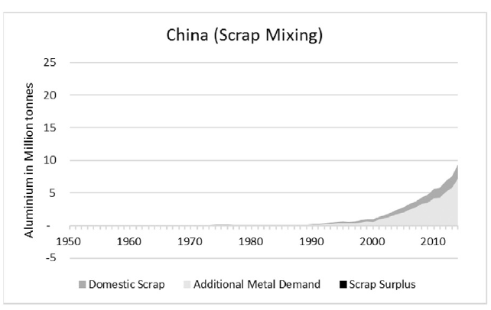
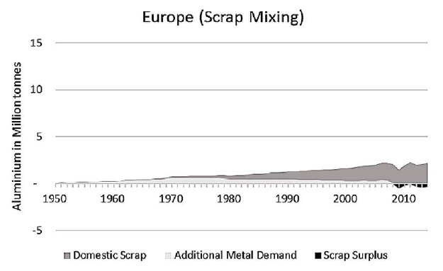
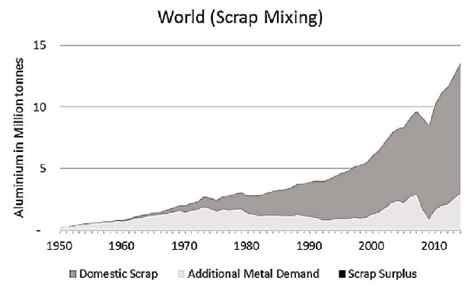
Answer to the research question and conclusions (2/2)
Interpretation
Aluminium Scrap recycling
China needs to import 4Mt/yr of scrap to avoid using primary metal (light grey)
Europe is net exporter of scrap (surplus scrap in Black)
Globally: recycled scrap reaches 11Mt/yr
This leaves a non-supplied recycled demand of 3Mt/year (light grey)

Slide 22
Lecture (II): Procedure, Application & Perspectives
❹ Perspectives & conclusions
̶̶ Other types of MFA according to OECD
̶ Other sustainability tools
̶ Summary of the lecture

Slide 23
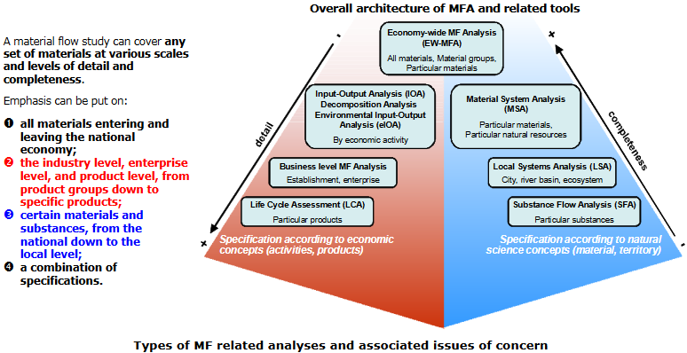
MFA: a family of tools
Source: Measuring material flows & resource productivity. Volume I. The OECD Guide (2008).

Slide 24
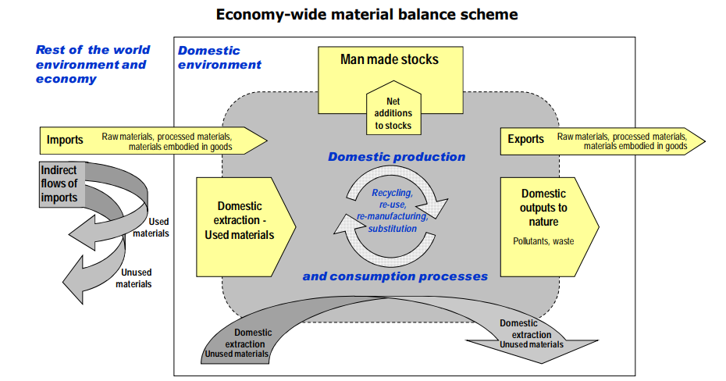
OCDE Top-Down Approach
Source: Measuring material flows & resource productivity. Volume I. The OECD Guide (2008).

Slide 25
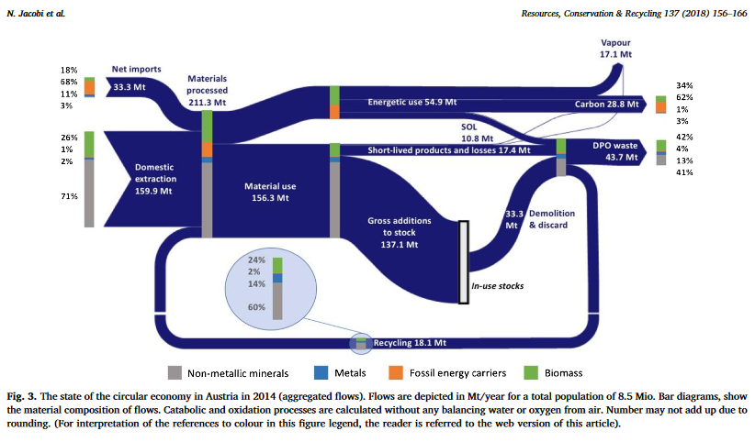
Example: economy-wide monitoring of the biophysical circular economy for Austria.

Slide 26
Lecture (II): Procedure, Application & Perspectives
❹ Perspectives & conclusions
̶̶ Other types of MFA according to OECD
̶ Other sustainability tools
̶ Summary of the lecture

Slide 27
Environmental Prioritization of Products (I/2)
Food, Mobility and Housing dominate (70 % of impacts at 50% expenditure)
Source: Journal Indust. Ecology 10:3 (2006)

Slide 28
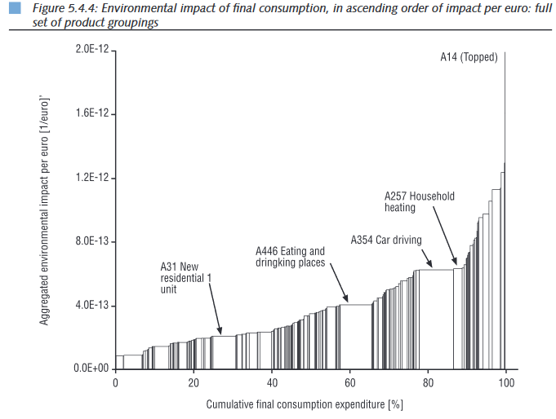
Environmental Prioritization of Products (2/2)
$$Impact=\text{[}\text{Impact}\text{/ € }\text{per} \text{product}\text{] }\text{x} \text{total} \text{expenditure}$$
surface is a measure for priority
figure indicates if shift in expenditure makes environm. sense and if ‘rebounds’ are possible
Source: Tukker et al. 2006.
Environmental Impact of Products (EIPRO

Slide 29
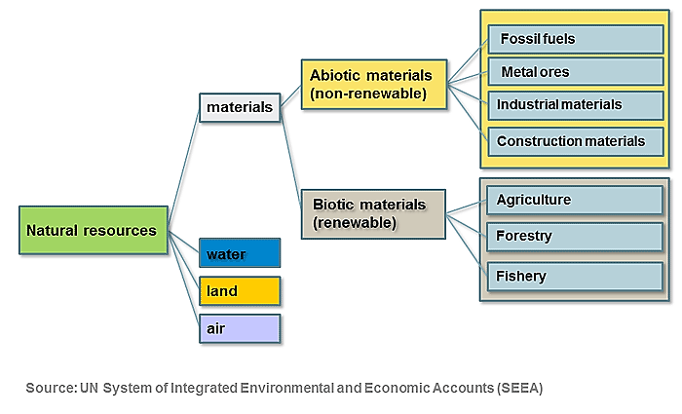
National level resource accounting: System for Environmental & Economic Accounts (SEEA)

Slide 30
Integration of tools at various levels
Questions at various levels
Indicators
Tools available
GDP, EF, etc.
EE Input-Output tables
& Env. accounts
Macro
Meso
Material Flow analysis
Micro
Life Cycle Assessment
Different system analytical tools and a consistent set of indicators are necessary to ensure innovation moves towards a sustainability

Slide 31
Lecture (II): Procedure, Application & Perspectives
❹ Perspectives & conclusions
̶̶ Other types of MFA according to OECD
̶ Other sustainability tools
̶ Summary of the lecture

Slide 32
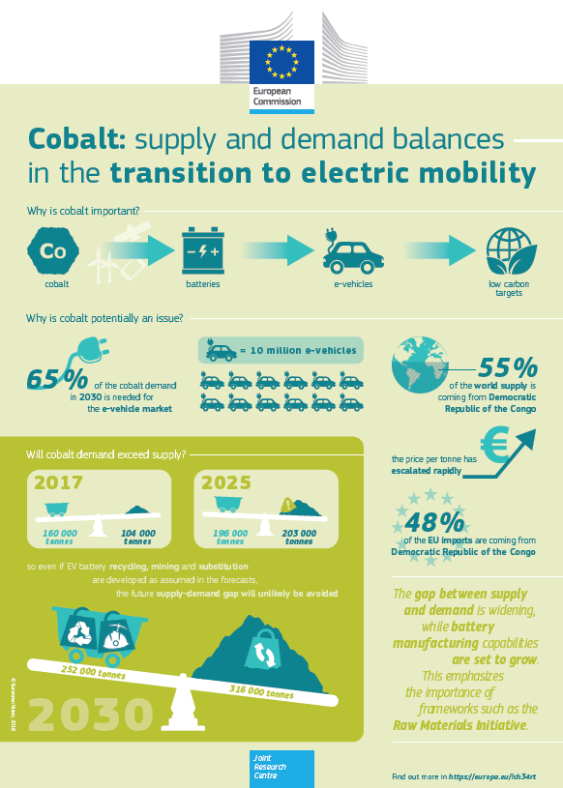
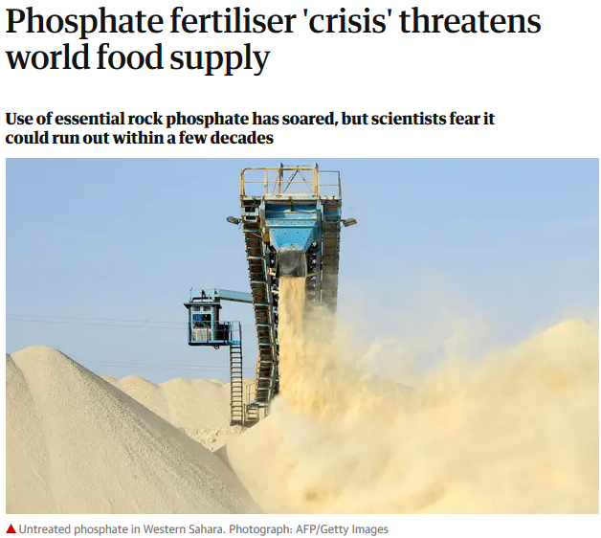
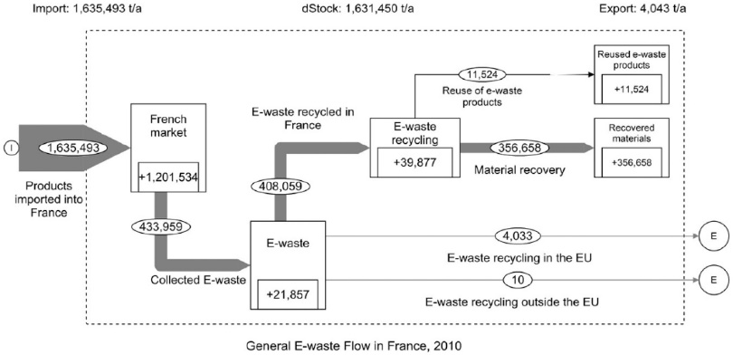
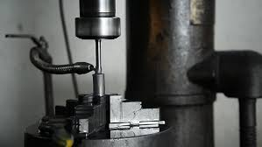

Examples of potential student projects
❶ Cobalt (Co) in the European value chain of electric mobility
❷ Machinery tools in the French economy – Focus on the Tungsten
❸ Supply of phosphate fertiliser: Potential of recycling from wastewater in Nouvelle Aquitaine region
Source: Vadoudi et al. 2015
Source: the Guardian

Slide 33
Thanks for you attention
Prof. Guido Sonnemann ​
guido.sonnemann@u-bordeaux.fr​
CyVi​
Research group on Life Cycle Assessment & sustainable chemistry
Institut des Sciences Moléculaires - ISM​
Université de Bordeaux – UMR 5255 CNRS​
351 Cours de la libération – Bât A12​
33 405 TALENCE cedex – France​
Tél : 05 40 00 31 83​
Web : http://www.ism.u-bordeaux1.fr​

